Slide 1
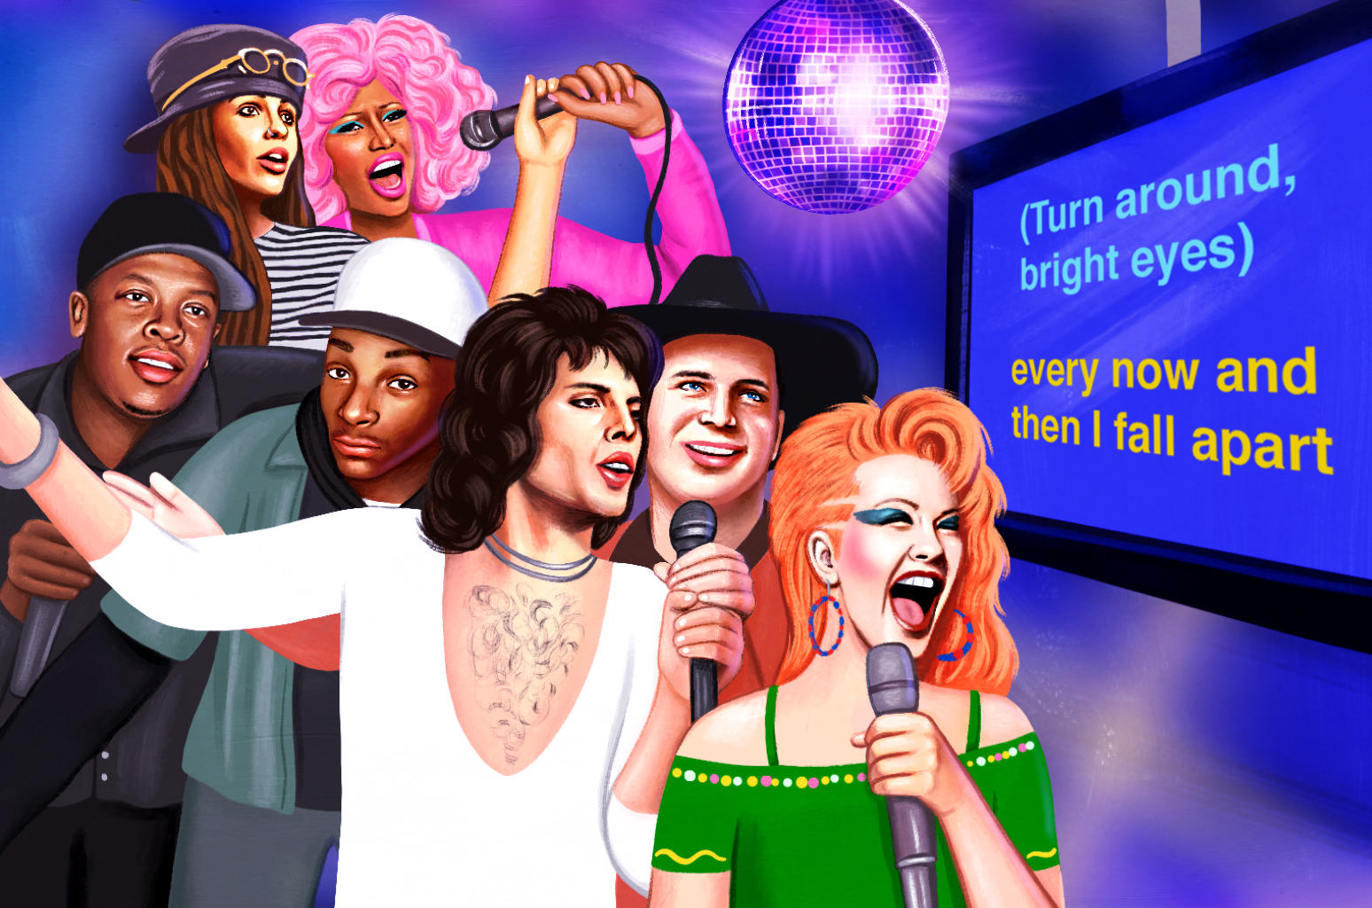
Midterm Presentation Karaoke Maker
Students: Izar Hasson
Supervisor: Hadas Ofir
Semester: Winter, 2023
Date: [18/01/23]

Slide 2
Outline
Project goal
Background
Motivation
Literature survey
Presenting project
conclusion

Slide 3
Project Goal
Building a module that can receive a song and will be able to separate the vocals from the background music.
We want to achieve that using deep learning methods.
Problems:
-No straightforward solutions for deep learning methods
-Need a lot of data for training.

Slide 4
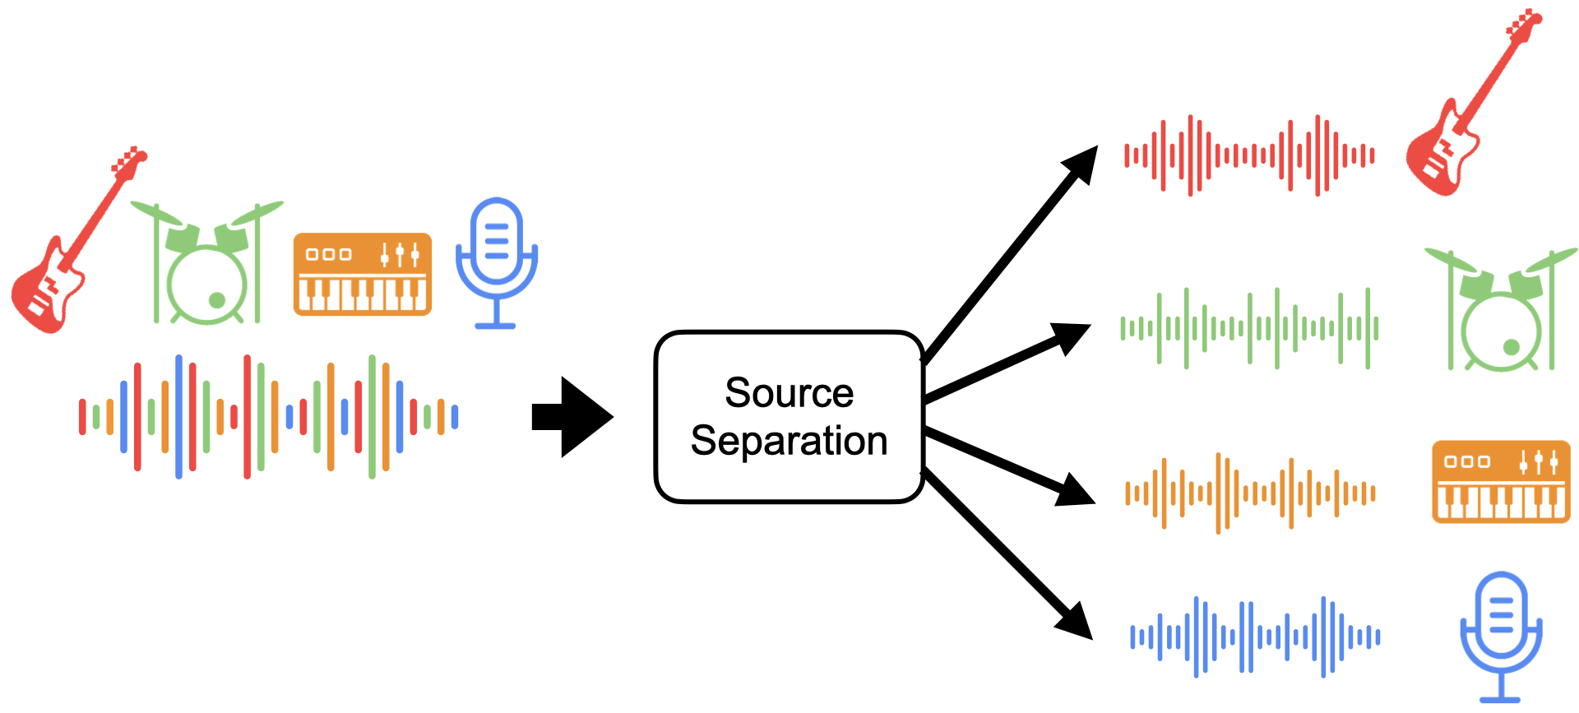
Background
A song is various channels that are added together, each channel holds different information for the song.
We want to separate it back.

Slide 5
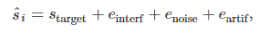
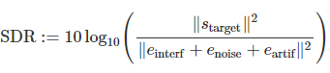
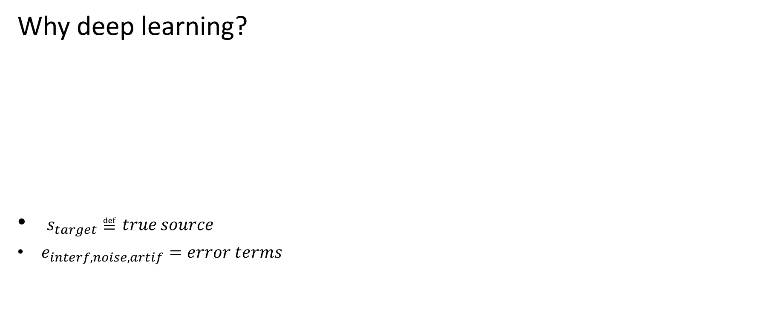
Background
Why deep learning?
$s_{target}≝true source$
$e_{interf,noise,artif}=error terms$
Notes:
Interests me, and just the best right now

Slide 6
Motivation
The obvious use: Karaoke!
Relevant for other practical and modern uses:
Music Remixing
Music Education
Song Lyrics Recognition (currently used in YouTube videos and Apple music)
Shed light on other related tasks such as speech enhancement and separation

Slide 7
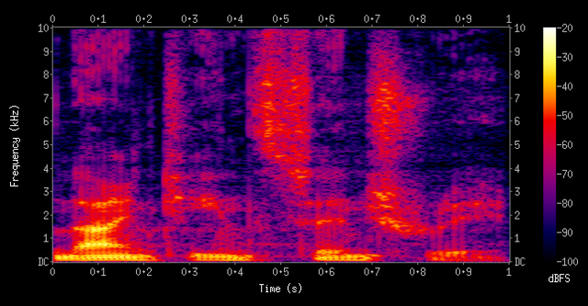
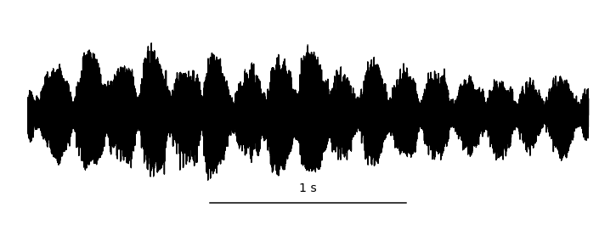
Literature Survey
Audio data is mainly analyzed in two domains
Time-Frequency domain Time domain
Theoretically there should be no difference between the methods, however, this holds true only if we have infinite amount of training data.

Slide 8
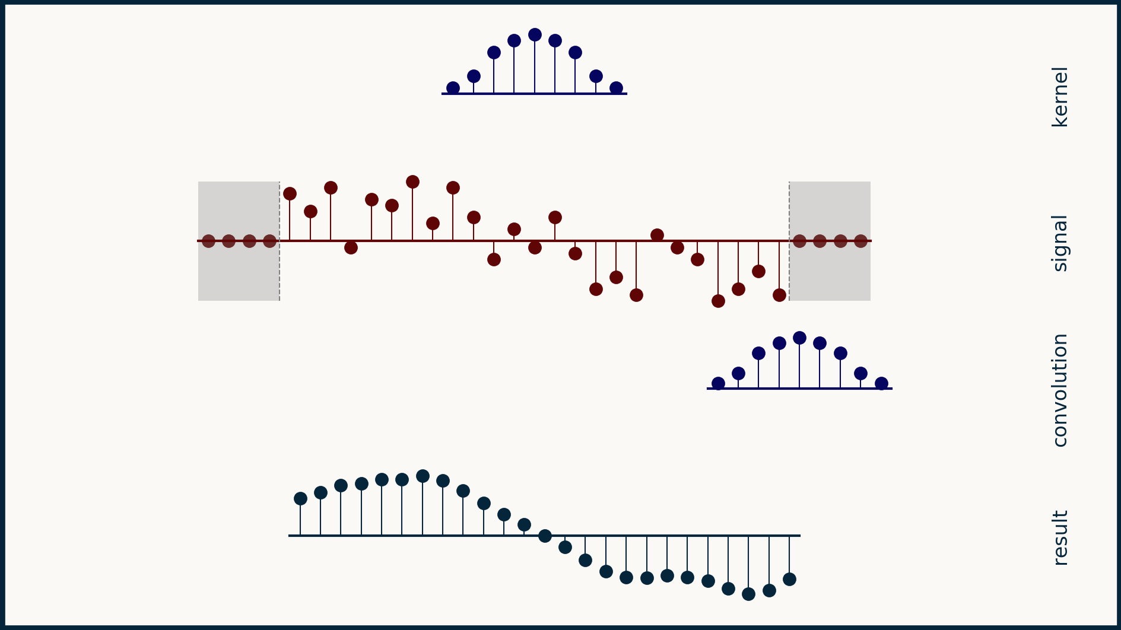
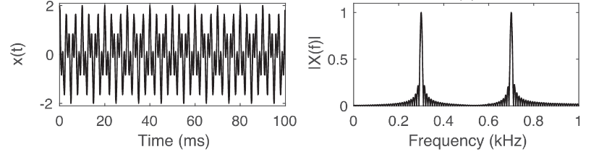
Comparing the domains
Time domain:
Pros: Doesn’t require any pre-processing.
Cons: must use layers with respect to
their channels.

Slide 9
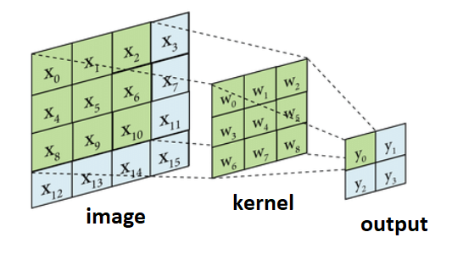
Comparing the domains
Time-Frequency domain:
Pros: Possible to apply convolutions along frequencies, reduces the computing complexity compared to the fully connected layers.
Cons: Does require pre-processing.

Slide 10
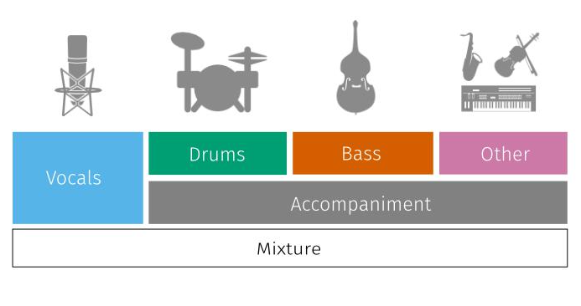
Dataset
MUSDB18:
150 full lengths music tracks (~10h duration)
Different genres
Isolated drums, bass, vocals and others stems.
Free

Slide 11
Chosen domain: Time-Frequency domain
1. Overall reduced computing complexity
2. Generally produces better results on the MUSDB18 dataset

Slide 12
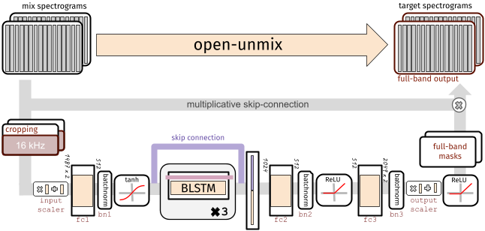
The OpenUnmix DNN module
We will use the DNN from the openUnmix.

Slide 13
The Project
Modifying the module by Combining two modules into one:
Training Open-unmix alone on the dataset
Training our modified version on the dataset
Checking the delta of performance
Input song
Band split module
The OpenUnmix DNN module
The mask estimation module

Slide 14
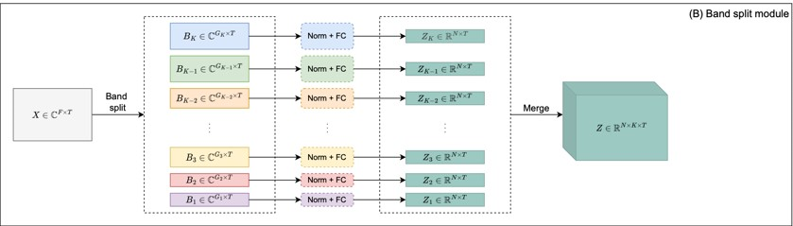
The Band Split Module
Input song
Band split module
Open Unmix
Mask estimation
Input: complex-valued spectrogram generated by STFT.
F , T - the frequency and time dimensions.
K- number of bands.
N- the chosen size of the dimension of the latent space.
This preprocessing should benefit the overall system and yield better results.

Slide 15
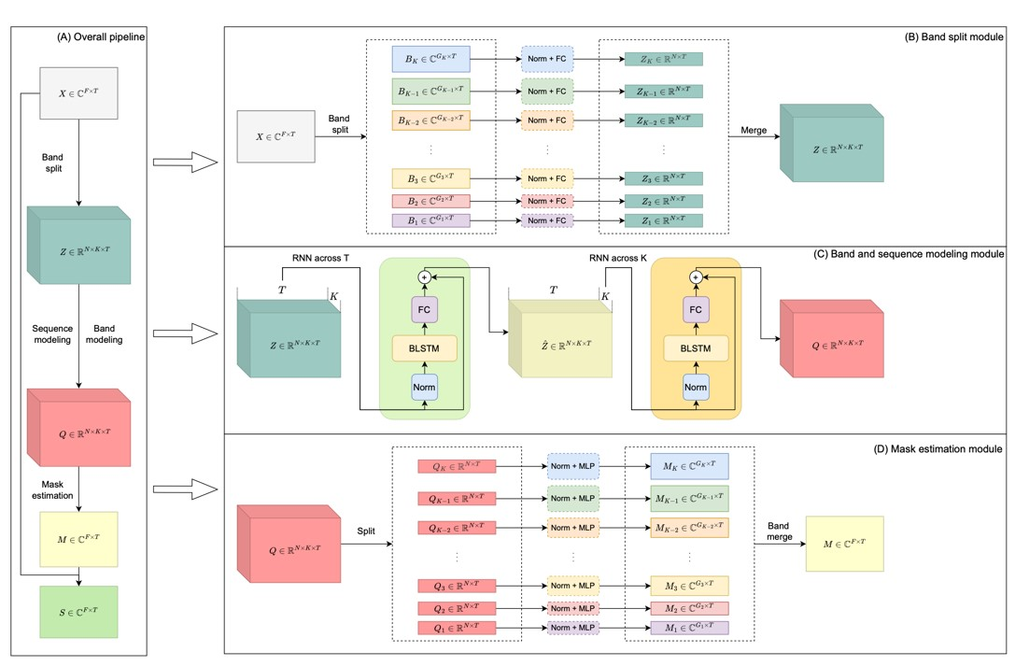
The Mask Estimation Module
Input song
Band split module
Open Unmix
Mask estimation
The module reconnects every band to the final mask

Slide 16
Conclusion
The project is modifying a module by combining two ideas and then checking the delta of performance, hoping for an improvement, without adding a lot of computational complexity.
Modified Open-Unmix module

Slide 17
Work so far
Heavy literature survey
Learning the audio separation world from scratch
Open-unmix ready to be trained
What’s left:
Training the open-unmix
Modifying the open-unmix so it can accept the separated bands and adding the modules together

Slide 18
References
https://paperswithcode.com/sota/music-source-separation-on-musdb18?p=open-unmix-a-reference-implementation-for all the papers trained on the dataset
https://doi.org/10.5281/zenodo.1117372 Zafar Rafii and Antoine Liutkus et Al. “The MUSDB18 corpus for music separation.” (2017)
https://arxiv.org/pdf/2209.15174.pdf Yi Luo, Jianwei Yu. “Music Source Separation with Band-split RNN.” EESS Audio and Speech Processing (2022)
https://www.theoj.org/joss-papers/joss.01667/10.21105.joss.01667.pdf Fabian-Robert Stöter, Stefan Uhlich, Antoine Liutkus, and Yuki Mitsufuji. “Open-Unmix - A Reference Implementation for Music Source Separation.” Journal of Open Source Software (2019)

